Slide 1
XInsight: eXplainable Data Analysis Through The Lens of Causality
Group 25

Slide 2
Introduction
Exploratory data analysis (EDA) is key to acquiring insight from data and facilitating analysis towards decision making but makes it difficult for users to justify and rely on knowledge and conclusions from EDA.
EXplainable Data Analysis (XDA) is a topic that focuses on developing methods for explaining the results of data analysis. Existing tools (Tableau’s Explain or Scorpion) provide non-causal explanations.
XDA aims to provide qualitative and / or quantitative explanations to Why Queries (Target and Context).
Enhances human understanding and confidence in data analysis outcomes and helps users take more informed decisions.
Xinsight is proposed as a unified, causality-based XDA framework that qualitatively and quantitatively answers WHY QUERY raised by users.

Slide 3
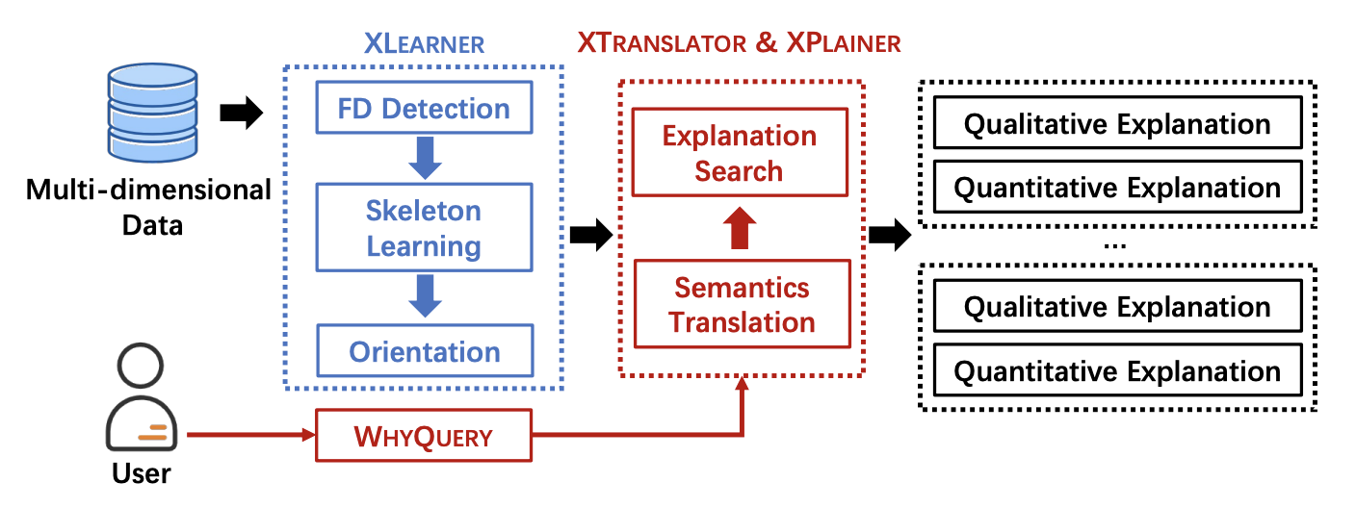
XInsight Framework
Overview of XInsight :
XInsight is a framework for XDA that is based on the concept of causality (independence-based causal discovery)
XInsight provides a unified way to explain why certain data facts are observed
Components of XInsight :
XLearner - Causal graph extraction (Offline)
XTranslator - Causal primitive translation
XPlainer - Quantitative contribution quantification

Slide 4
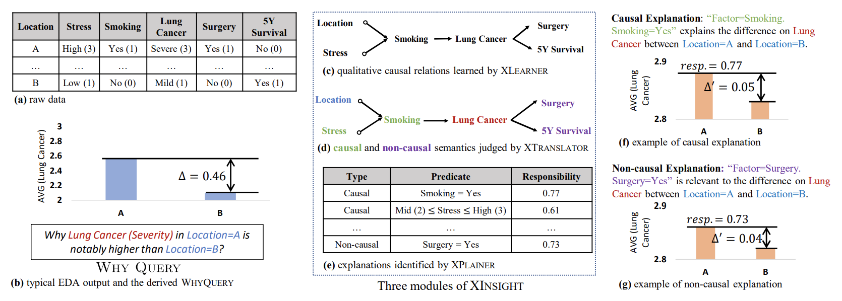
Example of XInsight

Slide 5
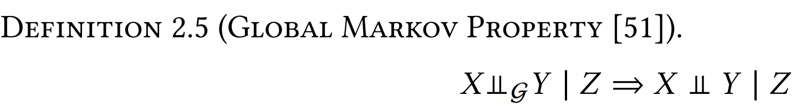
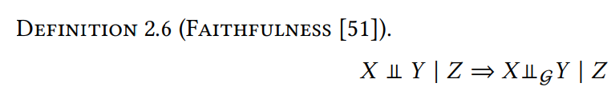
Global Markov Property AND Faithfulness
Global Markov Property (GMP): allows us to deduce statistical conditional independence in data from m-separations.
How to go from a causal Graph to data distribution (we don’t have a causal graph at the beginning)
Faithfulness: Two variables are conditionally independent by a set of variables in data then they are m-separated by the same set of variables within the causal graph.
Faithfulness and GMP together establish the equivalence between conditional independence and m-separation and they are the key for independence-based causal discovery.
XInsight leverages Functional dependencies to construct a FD-induced graph (acyclic). FD relations can violate faithfulness assumption. XInsight tackles this problem effectively.

Slide 6
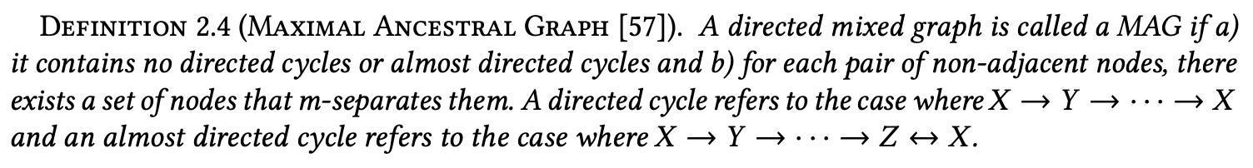
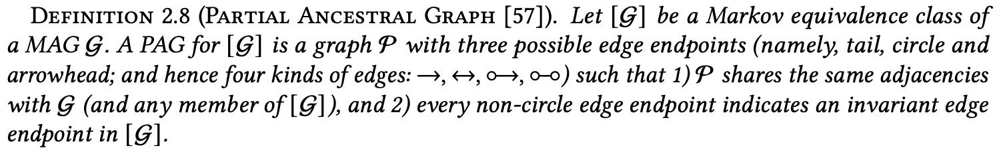
Maximal and Partial Ancestral Graphs
There may exist multiple MAGs that are equally consistent with the m-separations and not distinguishable, which is called Markov equivalence class, denoted by [G]. (share same skeleton but direction is different). These MAG’s are summarized into a compact representation called Partial Ancestral Graph (PAG) with some undetermined edge endpoints.

Slide 7
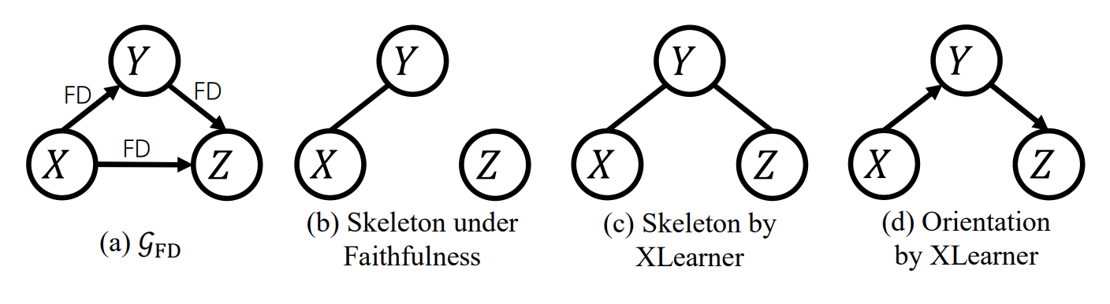
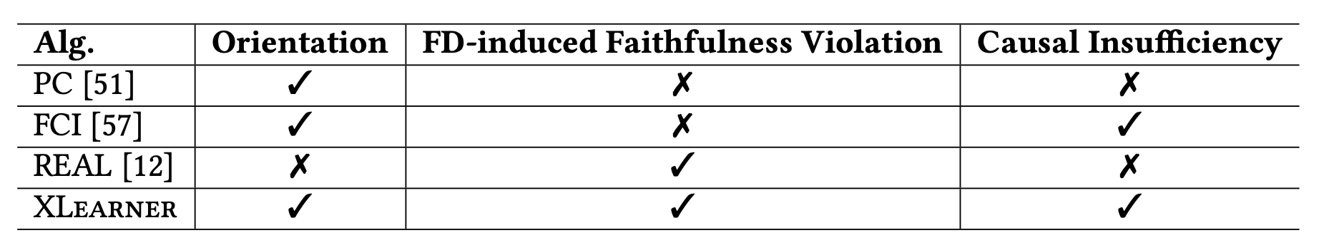
XLearner
XLearner aims to learn a causal graph G from multi-dimensional data 𝐷 in the presence of latent confounders in the following steps :
Detect and preclude 𝑿_{FD} - identify faithfulness violations
Standard PAG learning - FCI algo over faithfulness assumption compliant variables to generate skeleton
Orient S1 and generate G - Skeleton orientation to generate an FD-augmented PAG
Finally, the standard PAG is combined with the FD-augmented PAG to generate the resultant PAG.
Ex - 𝑋 denotes city, 𝑌 denotes state, and 𝑍 denotes country

Slide 8
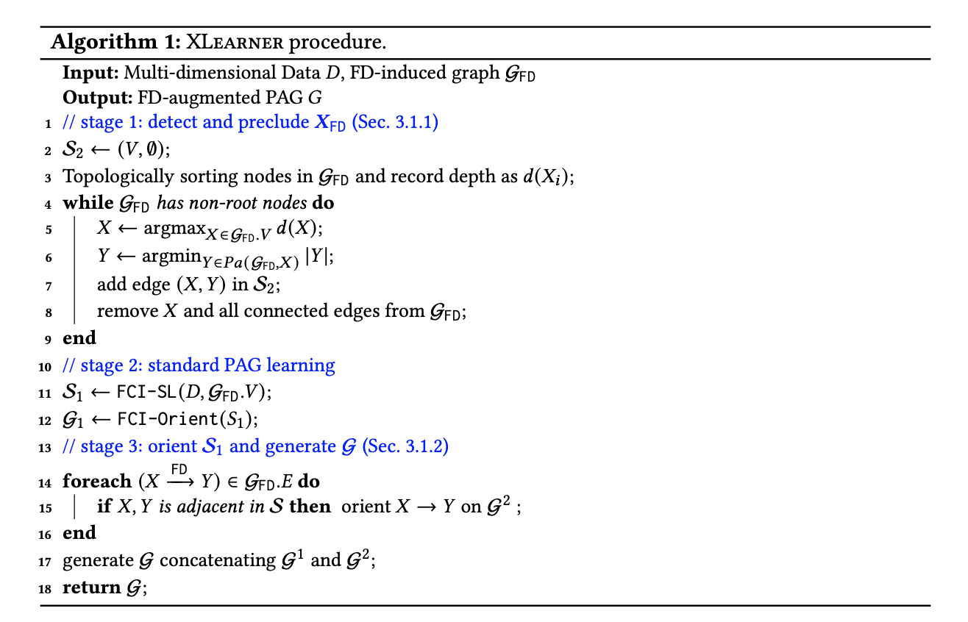
XLearner (Algo)

Slide 9
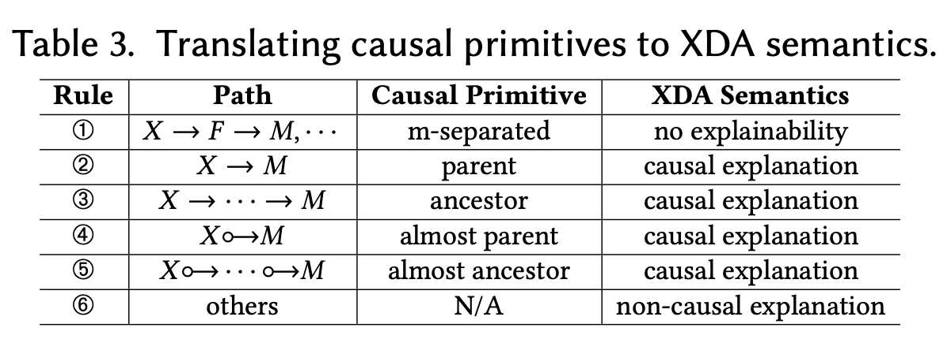
XTranslator
A causal graph does not directly reveal if a variable adequately explains a Why Query, nor does it directly reflect if the variable features a causal or non-causal explanation
Xtranslator bridges this gap which requires a translation from causal primitives to XDA semantics
Essentially a Why Query requires us to observe the difference between aggregates on 𝑀 within two subspaces
The principle is to impose a restriction and extract possible variables such that If 𝑋 is conditionally independent of 𝑀 given 𝐹 , 𝑋 is simply impossible to offer explanations to the WhyQuery.

Slide 10
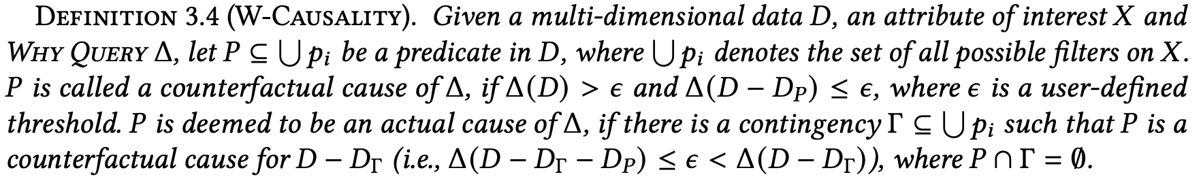
XPlainer
XLearner and XTranslator together provide a coarse-grained, variable-level qualitative explanation to a Why Query
It focuses on providing quantitative explanations at predicate level
XPlainer is based on DB causality (used for data provenance) which usually provides tuples as explanations
XPlainer takes care of the conciseness consideration and also significantly reduces the computing cost with theoretical guarantees

Slide 11
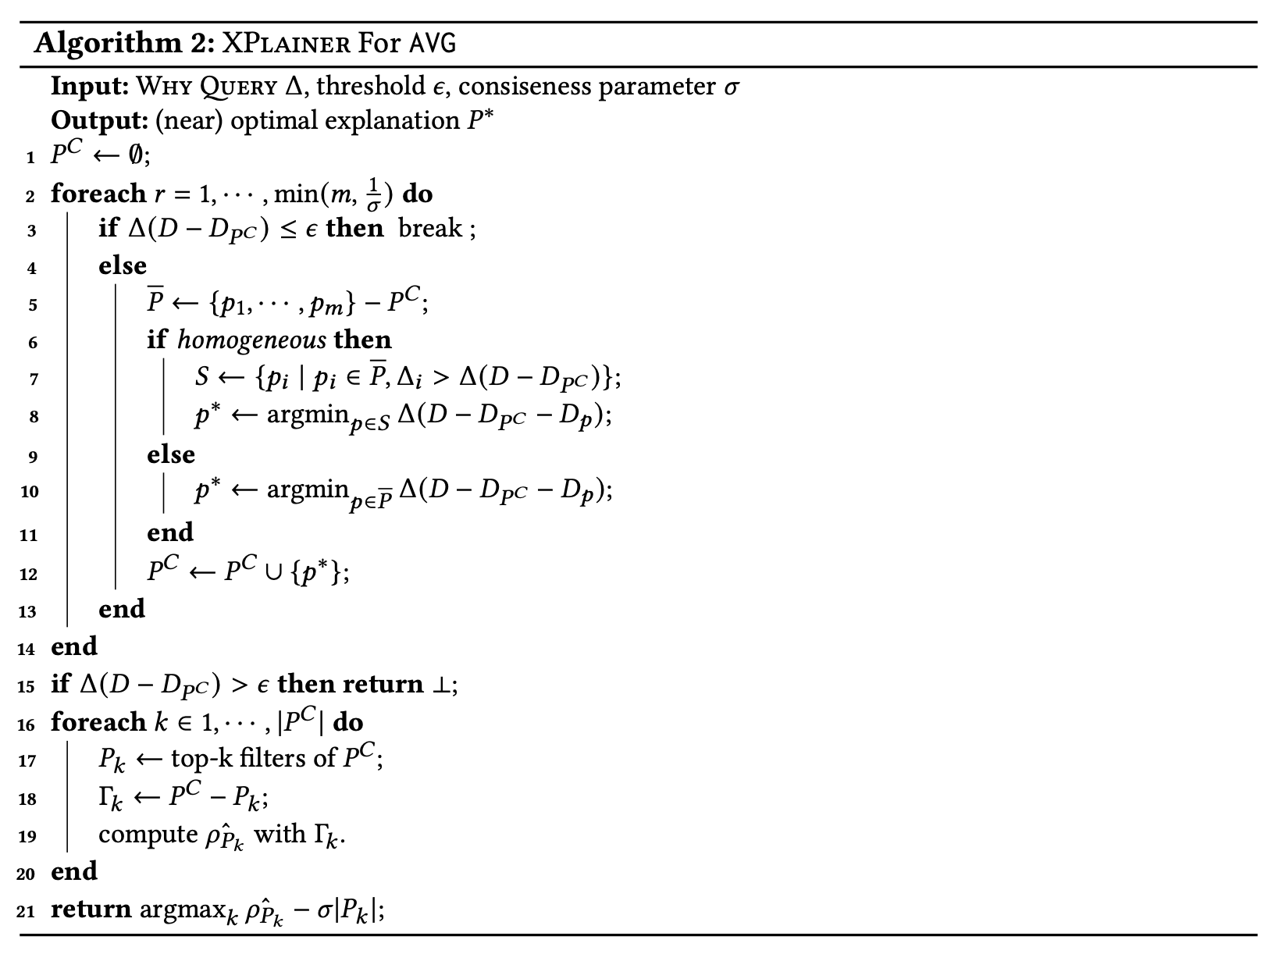
XPlainer (Algo)

Slide 12
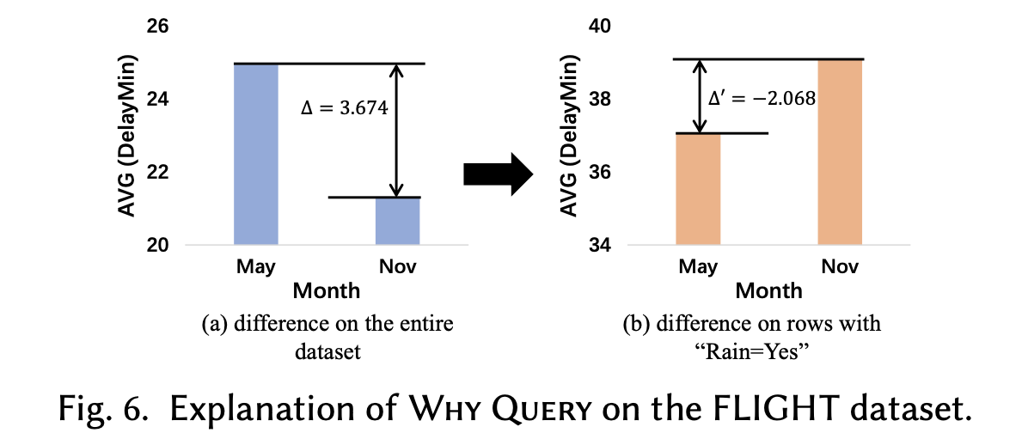
Results (Example)
Initial Observation - The duration of flight delay differs by month, particularly for May and November
Why Query to XInsight - what the cause of the flight delay difference is.
Process - It learns a casual graph and identifies rain as direct cause for delays. Then, XPlainer finds that the difference is reversed for “rain=Yes”.
Output - “rain=Yes” is the explanation returned by the model which looks correct as most states have rain in that season as well as the rains are the leading cause for delays in general

Slide 13
Conclusions
How can XInsight facilitate end users in explainable data analysis?
XInsight shows a promising end-to-end performance in explaining data differences. The user study validates that XInsight achieves a respectable level of agreement with experts.
Does XLearner effectively recover causal relations from observational data?
As reflected by the carefully-designed quantitative experiments and the user study, XLearner generates plausible causal graphs that are consistent with expert knowledge.
Does XPlainer accurately and efficiently yield explanations?
XPlainer shows high scalability to large datasets and also accurately generates explanations in very difficult settings. On a mild cost of precision, two approximation solutions of XPlainer substantially improve efficiency

Slide 14
Future Scope
Designing more comprehensive translation rule - XTranslator only focuses on variables with strong connections to 𝑀
FD in Noisy Data - XInsight only considers deterministic FD
Scalability of XInsight

Slide 15
Thank You

